Slide 1
AWS IoT pipeline

Slide 2
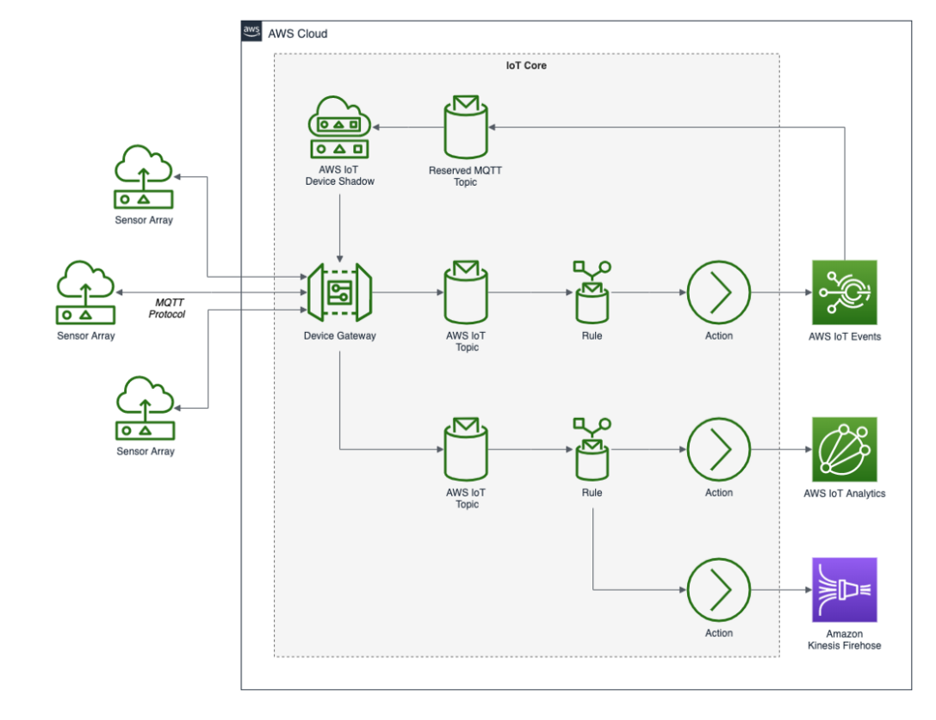
AWS IoT core platform
Gateway currently supports MQTT,
WebSockets, and HTTP 1.1 protocols
Once an MQTT message is received from an IoT device (a thing), we use AWS IoT Rules to send message data to an AWS IoT Analytics Channel.

Slide 3
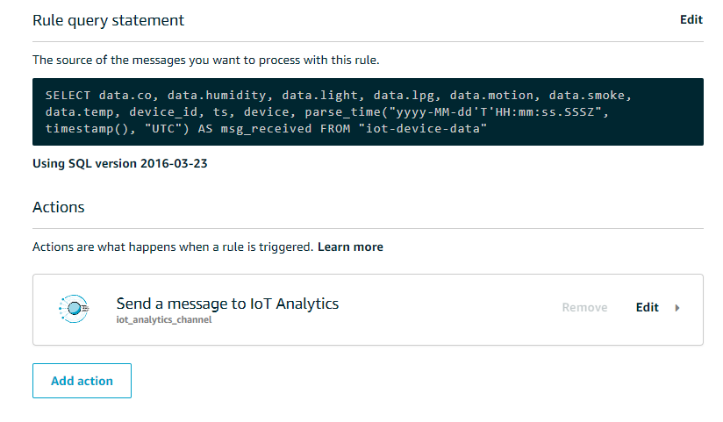
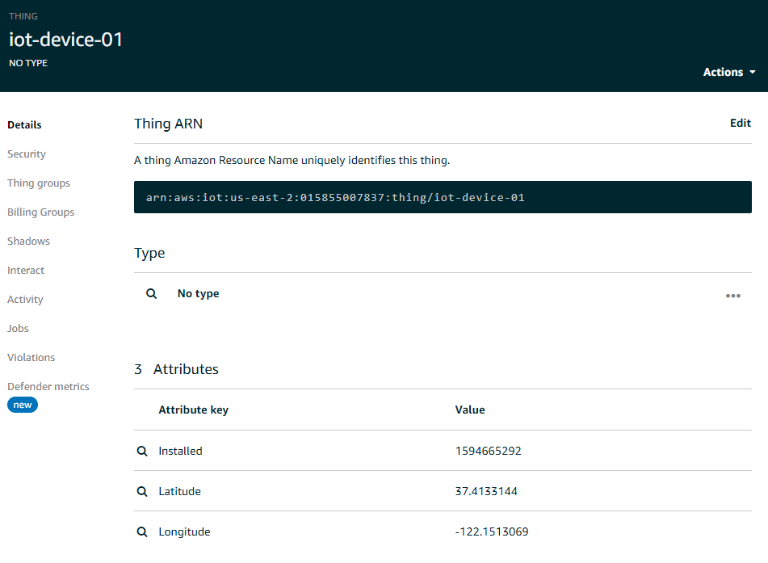
Things, rules and actions

Slide 4
AWS CloudFormation
Use the CloudFormation template, iot-analytics.yaml, to create an IoT Analytics stack containing (17) resources, including the following.
(3) AWS IoT Things
(1) AWS IoT Core Topic Rule
(1) AWS IoT Analytics Channel, Pipeline, Data store, and Data set
(1) AWS Lambda and Lambda Permission
(1) Amazon S3 Bucket
(1) Amazon SageMaker Notebook Instance
(5) AWS IAM Roles
https://towardsdatascience.com/getting-started-with-iot-analytics-on-aws-5f2093bcf704

Slide 5
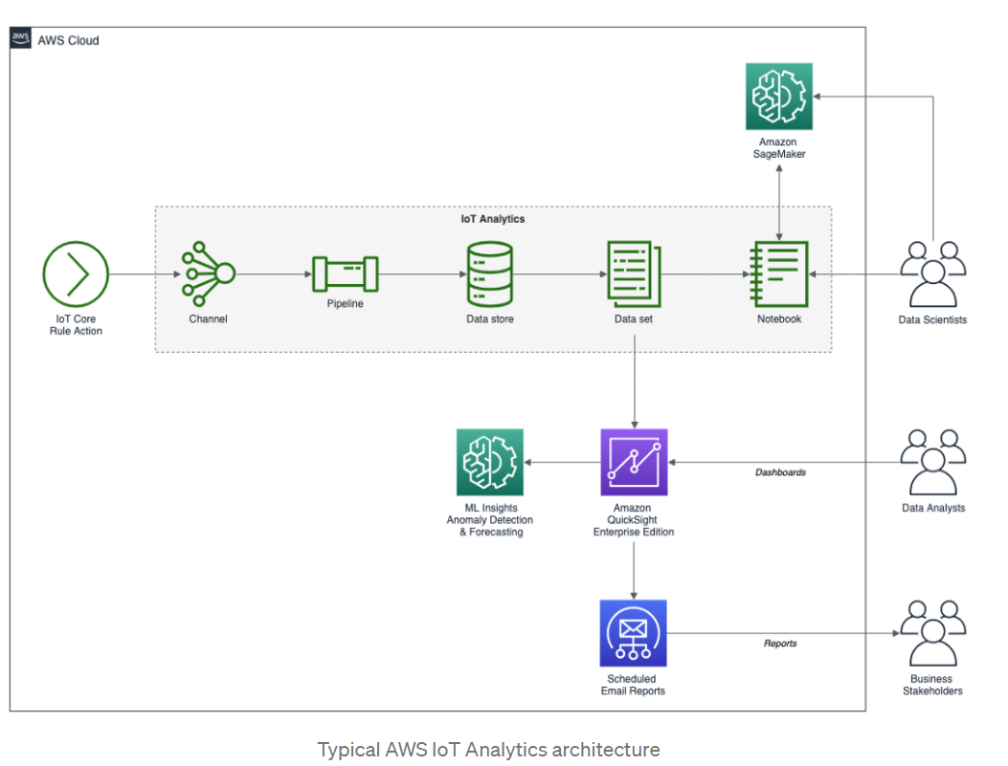
AWS IoT Analytics

Slide 6
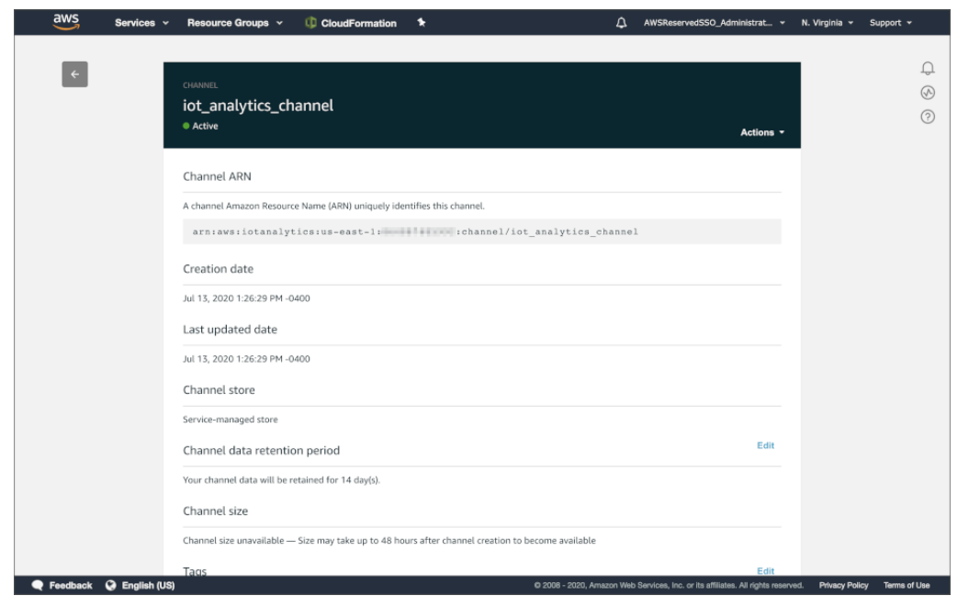
IoT Analytics Channel
AWS IoT Analytics Channel pulls messages or data into IoT Analytics from other AWS sources
E.g. Amazon S3, Amazon Kinesis, or Amazon IoT Core

Slide 7
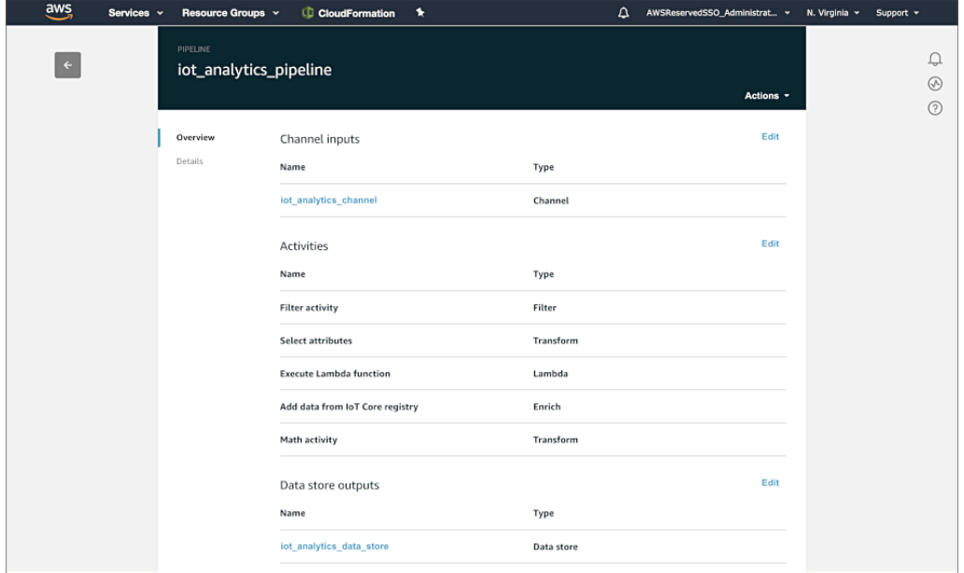
IoT Analytics Pipeline
AWS IoT Analytics Pipeline consumes messages from one or more Channels. Pipelines transform, filter, and enrich the messages before storing them in IoT Analytics Data stores

Slide 8
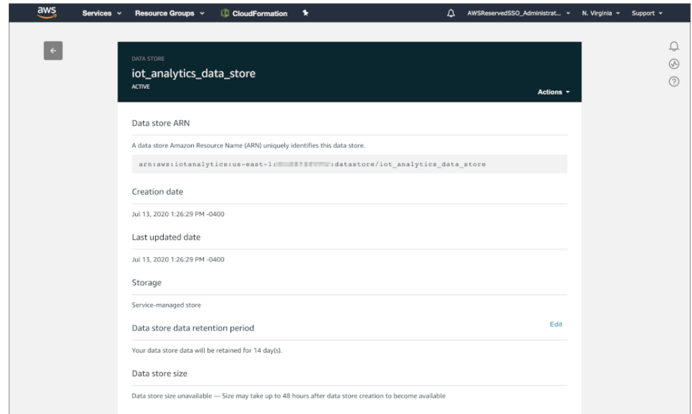
IoT Analytics Data store
AWS IoT Analytics Data store stores prepared data from an AWS IoT Analytics Pipeline, in a fully-managed database

Slide 9
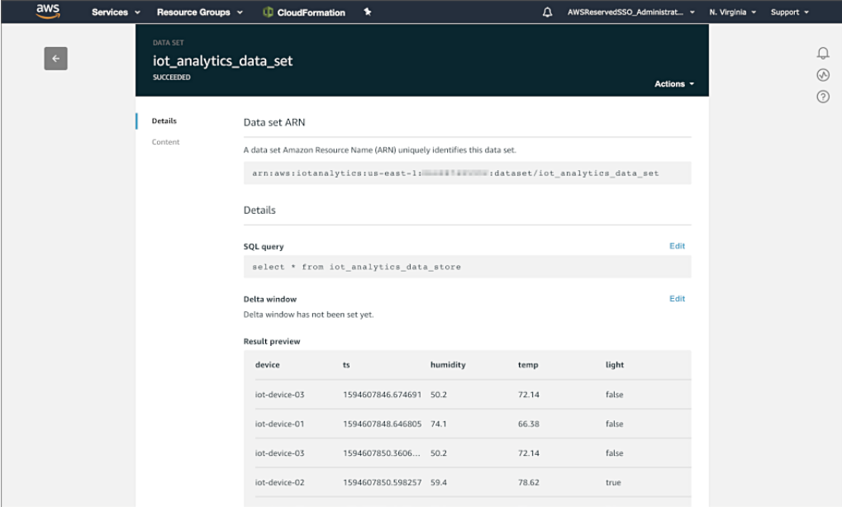
IoT Analytics Data set
AWS IoT Analytics Data set automatically provides regular, up-to-date insights for data analysts by querying a Data store using standard SQL

Slide 10
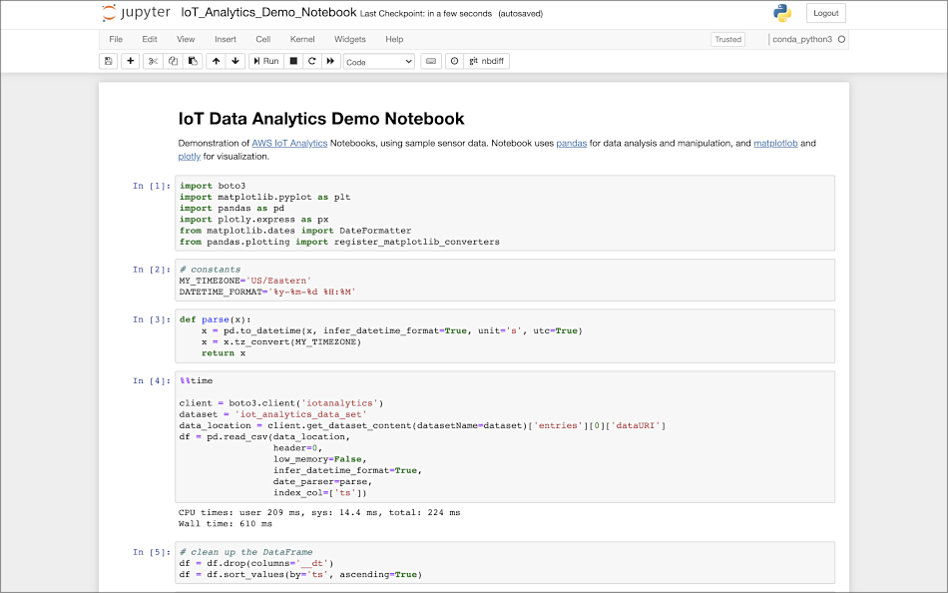
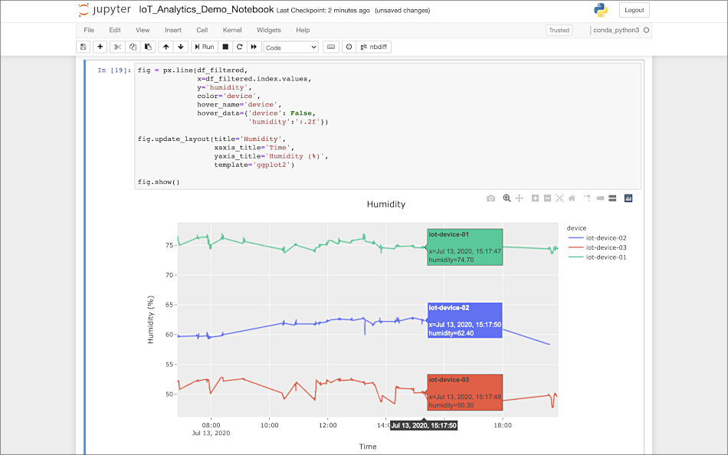
IoT Analytics Notebook
AWS IoT Analytics Notebook allows users to perform statistical analysis and machine learning on IoT Analytics Data sets using Jupyter Notebooks

Slide 11
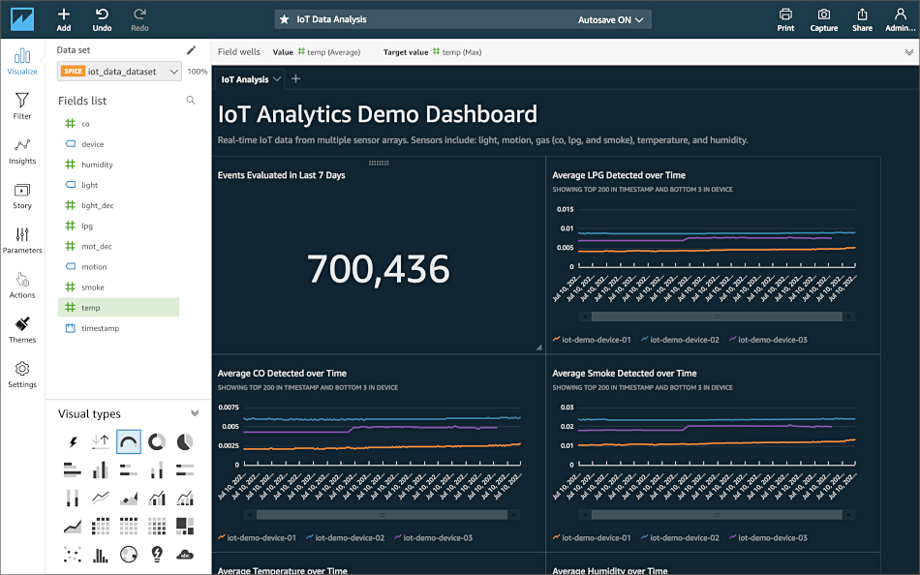
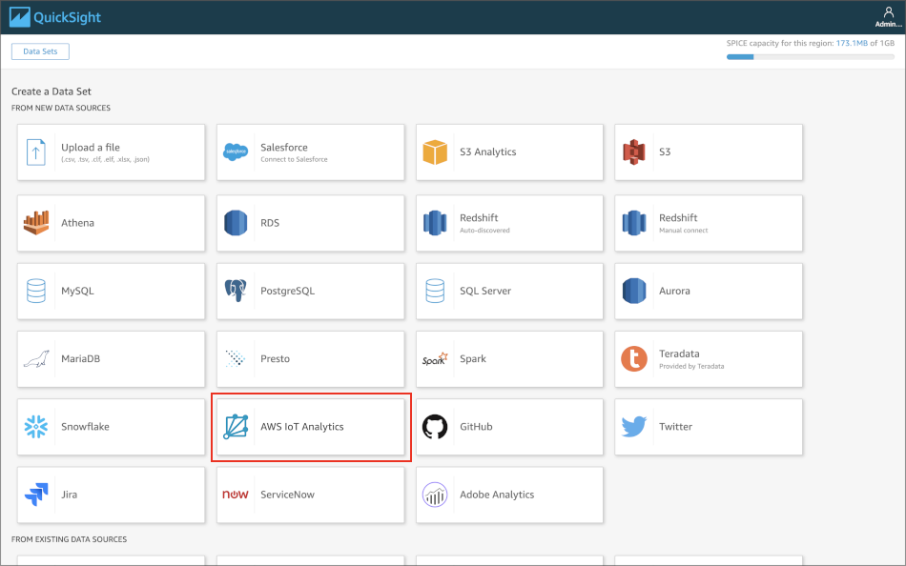
Amazon QuickSight
a wide variety of data source options for creating Amazon QuickSight Data sets

Slide 12
Predictive maintenance use case

Slide 13
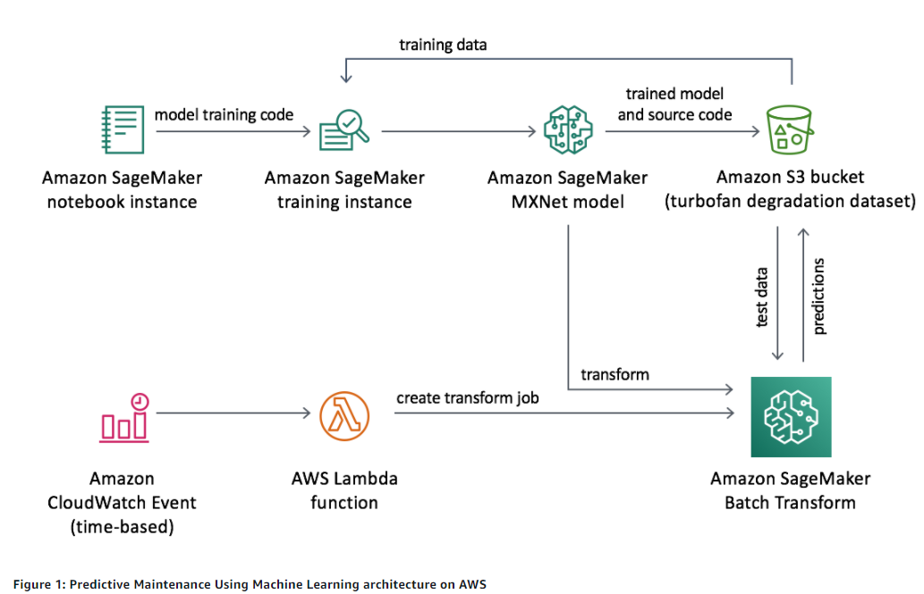
AWS Predictive maintenance architecture

Slide 14
AWS Predictive maintenance architecture
This solution includes an AWS CloudFormation template that deploys an example dataset of a turbofan degradation simulation contained in an Amazon Simple Storage Service (Amazon S3) bucket and an Amazon SageMaker endpoint with an ML model that will be trained on the dataset to predict remaining useful life (RUL).
The solution uses a SageMaker notebook instance to orchestrate the model, and a SageMaker training instance to perform the training. The training code and trained model are stored in the solution's Amazon S3 bucket.
The solution also deploys an Amazon CloudWatch Events rule that is configured to run once per day. The rule is configured to trigger an AWS Lambda function that creates an Amazon SageMaker batch transform job that uses the trained model to predict RUL from the example dataset.

Slide 15
Steps to deploy
Step 1. Launch the Stack
Launch the AWS CloudFormation template into your AWS account.
Enter values for the required parameters: Stack Name, Model and Data Bucket Name
Review the other template parameters, and adjust if necessary.
Step 2. Run the Notebook
Run the Jupyter Notebook to train the ML model.
Step 3. Enable the CloudWatch Events Rule
Enable the Amazon CloudWatch Events rule.
Step 4. Verify the Lambda Function Is Processing Data
Verify that the AWS Lambda function is processing data.

Slide 16
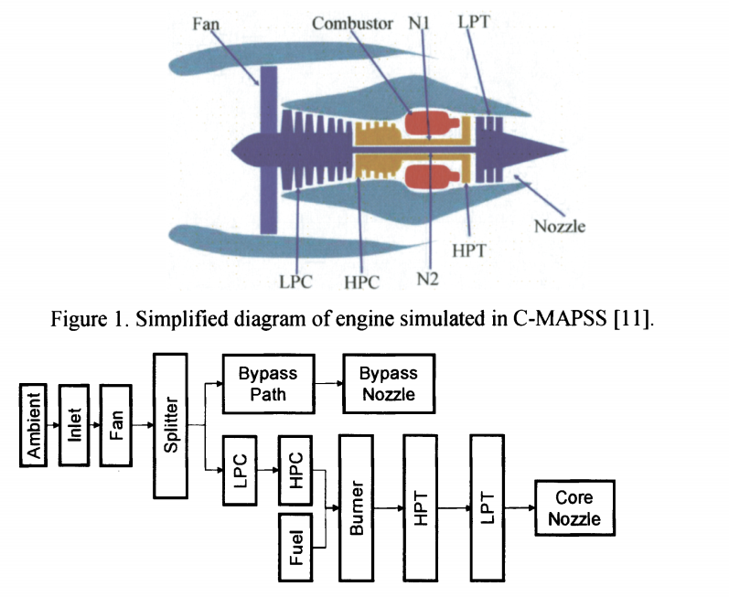
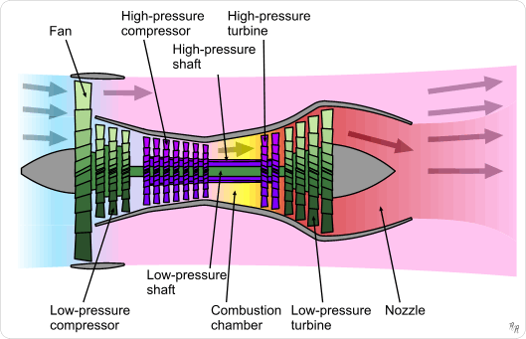
Turbofan architecture

Slide 17
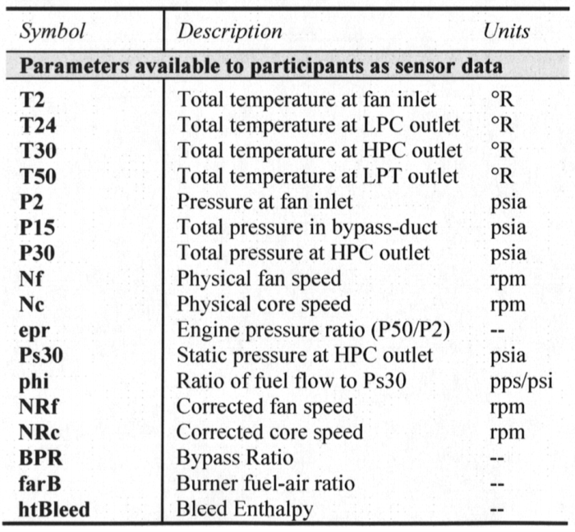
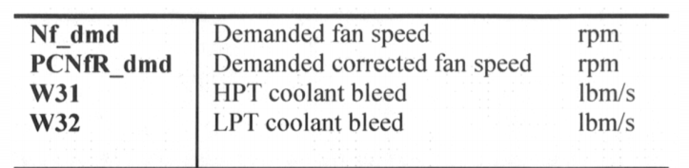
Measurement sensor

Slide 18
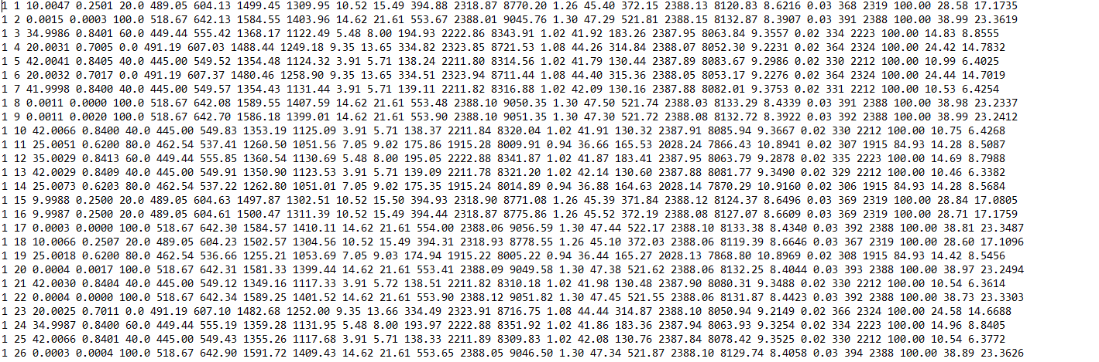
Data set

Slide 19
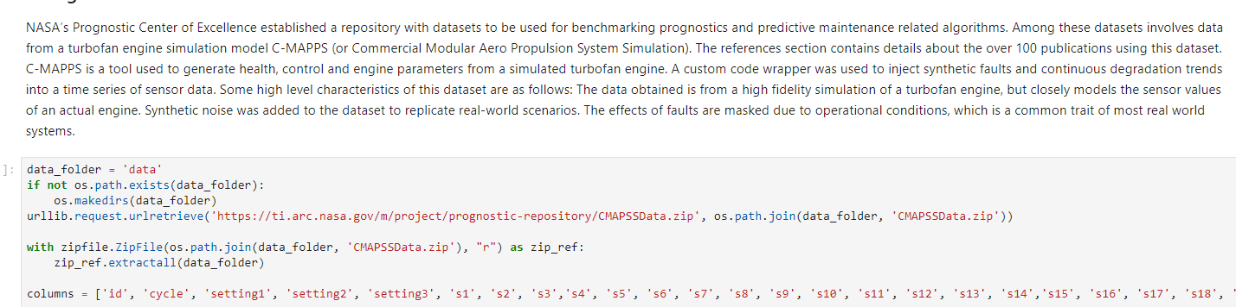
Prepare train data
Engine setting
(altitude, march, sea-level temperature)
Sensor measurement

Slide 20
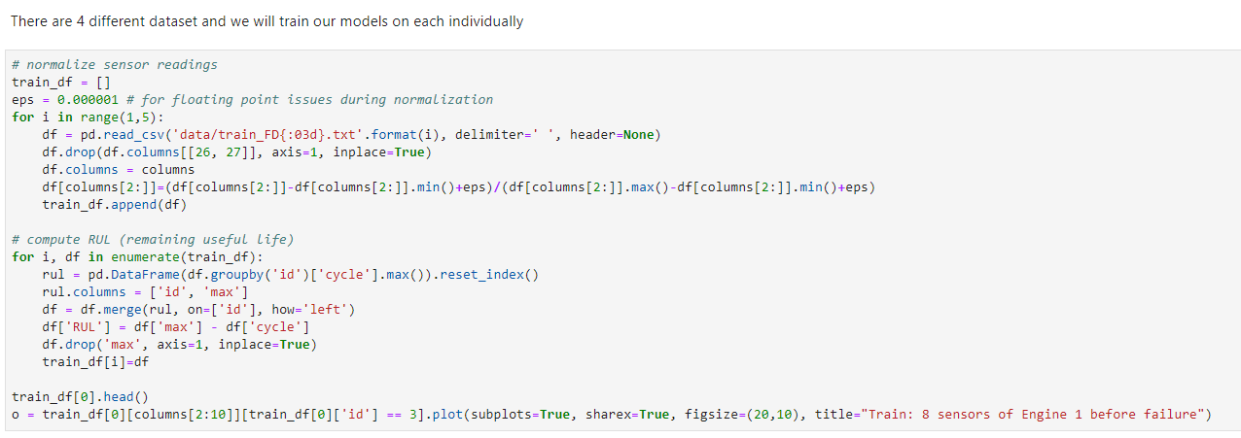
Prepare train data

Slide 21
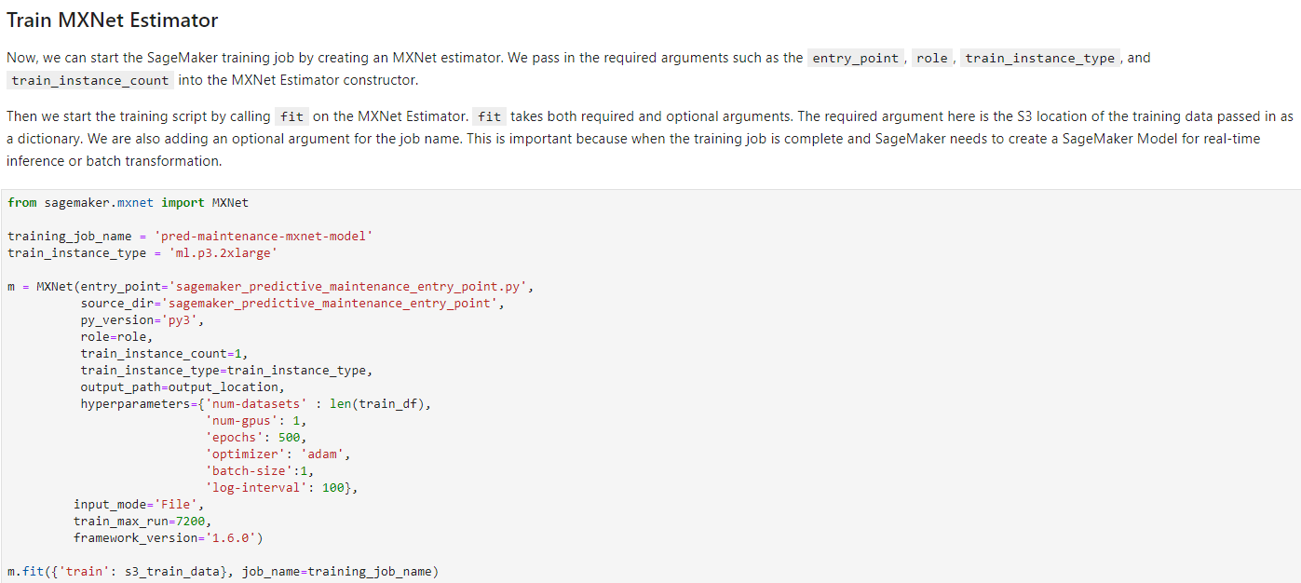
Create model and train

Slide 22
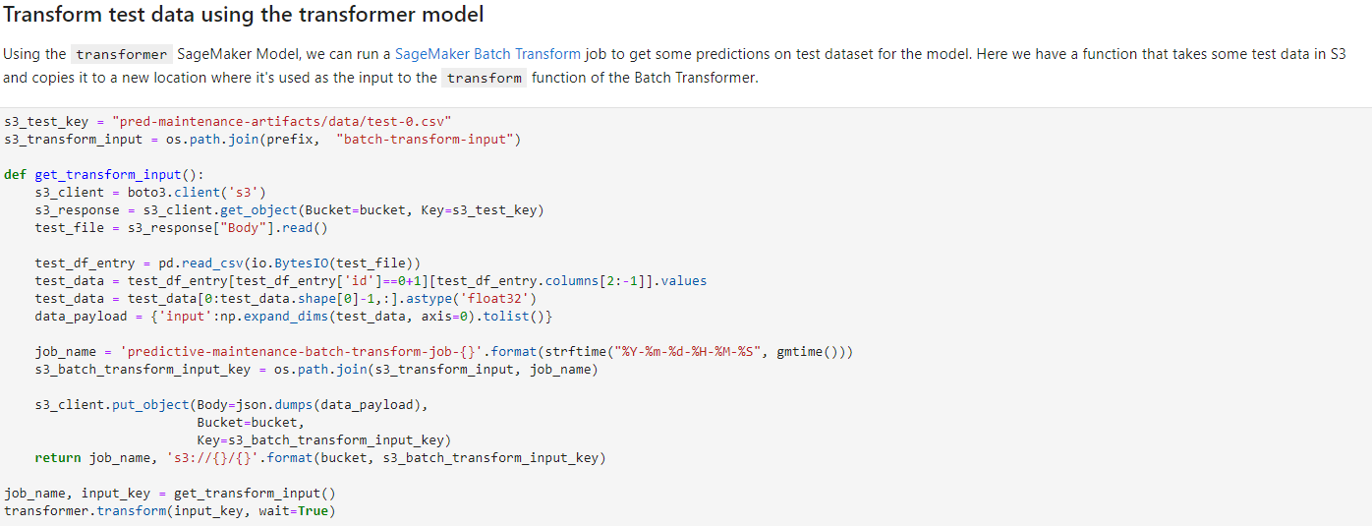
Transform test data

Slide 23
Steps to build, train, test a model in a notebook

Slide 24
Prepare a notebook instance
Create a notebook instance: name, instance type, IAM role
# Define IAM role
role = get_execution_role()
prefix = 'sagemaker/DEMO-xgboost-dm'
containers = {'us-west-2': '433757028032.dkr.ecr.us-west-2.amazonaws.com/xgboost:latest', 'us-east-1': '811284229777.dkr.ecr.us-east-1.amazonaws.com/xgboost:latest', 'us-east-2': '825641698319.dkr.ecr.us-east-2.amazonaws.com/xgboost:latest', 'eu-west-1': '685385470294.dkr.ecr.eu-west-1.amazonaws.com/xgboost:latest'} # each region has its XGBoost container my_region = boto3.session.Session().region_name # set the region of the instance print("Success - the MySageMakerInstance is in the " + my_region + " region. You will use the " + containers[my_region] + " container for your SageMaker endpoint.")

Slide 25
Prepare data
Create a S3 bucket: boto3 client Download data as csv, put into data frame
Spit train and test data
Upload to S3: boto3 client
bucket_name = 'your-s3-bucket-name' # <--- CHANGE THIS VARIABLE TO A UNIQUE NAME FOR YOUR BUCKET
s3 = boto3.resource('s3')
try: if my_region == 'us-east-1': s3.create_bucket(Bucket=bucket_name) else: s3.create_bucket(Bucket=bucket_name, CreateBucketConfiguration={ 'LocationConstraint': my_region })
print('S3 bucket created successfully') except Exception as e: print('S3 error: ',e)
try: urllib.request.urlretrieve ("https://d1.awsstatic.com/tmt/build-train-deploy-machine-learning-model-sagemaker/bank_clean.27f01fbbdf43271788427f3682996ae29ceca05d.csv", "bank_clean.csv") print('Success: downloaded bank_clean.csv.') except Exception as e: print('Data load error: ',e) try: model_data = pd.read_csv('./bank_clean.csv',index_col=0) print('Success: Data loaded into dataframe.') except Exception as e: print('Data load error: ',e)

Slide 26
Create model and train
Create input train data from data in S3
Create model, hyperparameters, train: sagemaker client
sess = sagemaker.Session() xgb = sagemaker.estimator.Estimator(containers[my_region],role, train_instance_count=1, train_instance_type='ml.m4.xlarge',output_path='s3://{}/{}/output'.format(bucket_name, prefix),sagemaker_session=sess) xgb.set_hyperparameters(max_depth=5,eta=0.2,gamma=4,min_child_weight=6,subsample=0.8,silent=0,objective='binary:logistic',num_round=100)
xgb.fit({'train': s3_input_train})

Slide 27
Deploy and infer
Deploy: instance type and endpoint → return predictor
Use predictor to infer
xgb_predictor = xgb.deploy(initial_instance_count=1,instance_type='ml.m4.xlarge')
test_data_array = test_data.drop(['y_no', 'y_yes'], axis=1).values #load the data into an array xgb_predictor.content_type = 'text/csv' # set the data type for an inference xgb_predictor.serializer = csv_serializer # set the serializer type predictions = xgb_predictor.predict(test_data_array).decode('utf-8') # predict! predictions_array = np.fromstring(predictions[1:], sep=',') # and turn the prediction into an array print(predictions_array.shape)

Slide 28
Steps to build, train, test a model using APIs

Slide 29
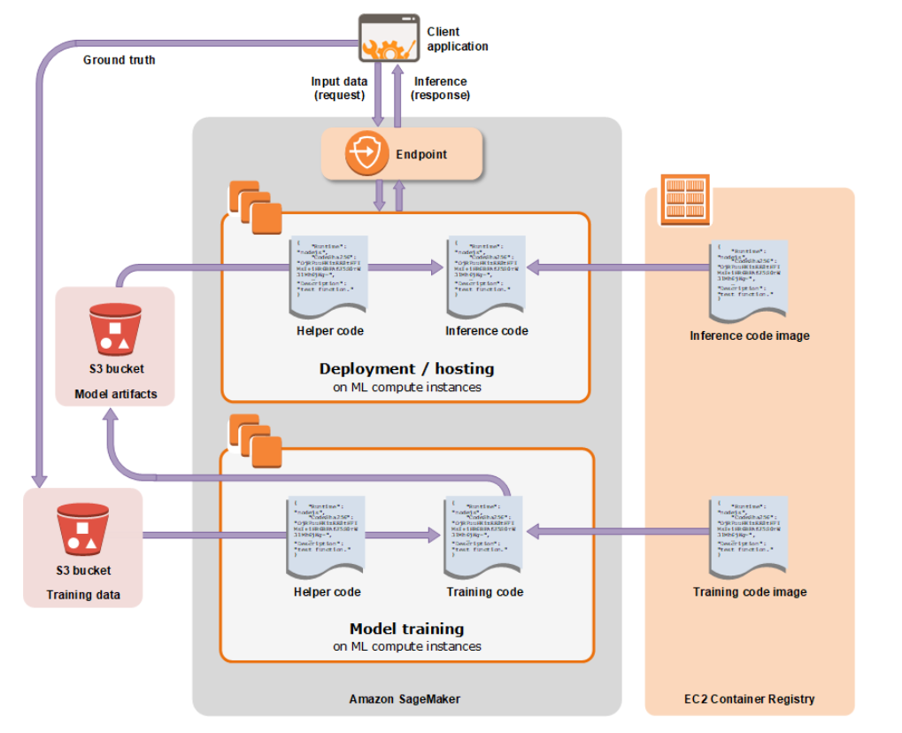
Sagemaker architecture

Slide 30
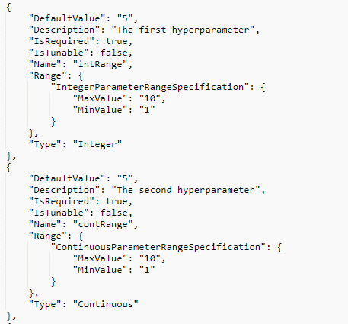
Create an algorithm
SageMaker built-in algorithm
Training spec
Name, training mage, instance
Channel: 20 channels of input sources
Tuning spec
Inference spec
Inference image, instance
Validation spec
Validataion profile
Training job definition
Transform job definition

Slide 31
Create training job
Jobname, role
Algorithm source: built-in, custom, container, subscription
Hyperparameters: depend algorithms
Computing resource
Instance type
Network resource
Input data
Dataset file on S3
Output data
Output model on S3

Slide 32
Hyperparameter tuning job
Tuning strategy
Random: chooses a random combination of values from within the ranges that you specify
Bayesian: hyperparameter tuning makes guesses about which hyperparameter combinations are likely to get the best results
Create training job definition
Algorithm, data input, output, configure resources
Configure tuning job resources

Slide 33
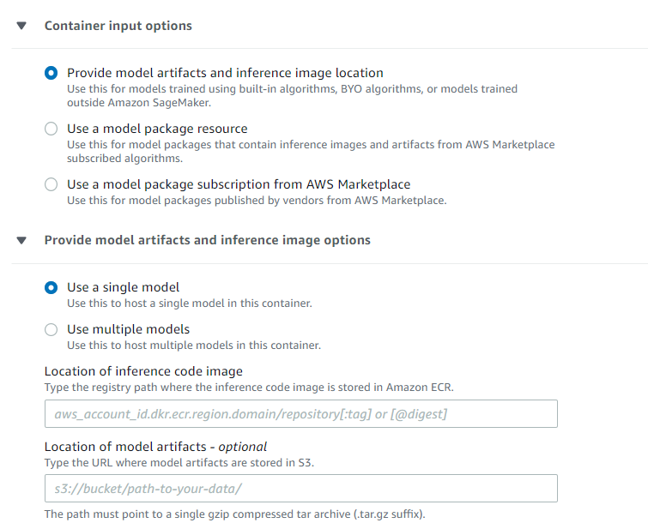
Create model
Model name, IAM role
Provide model artifacts and inference image location

Slide 34
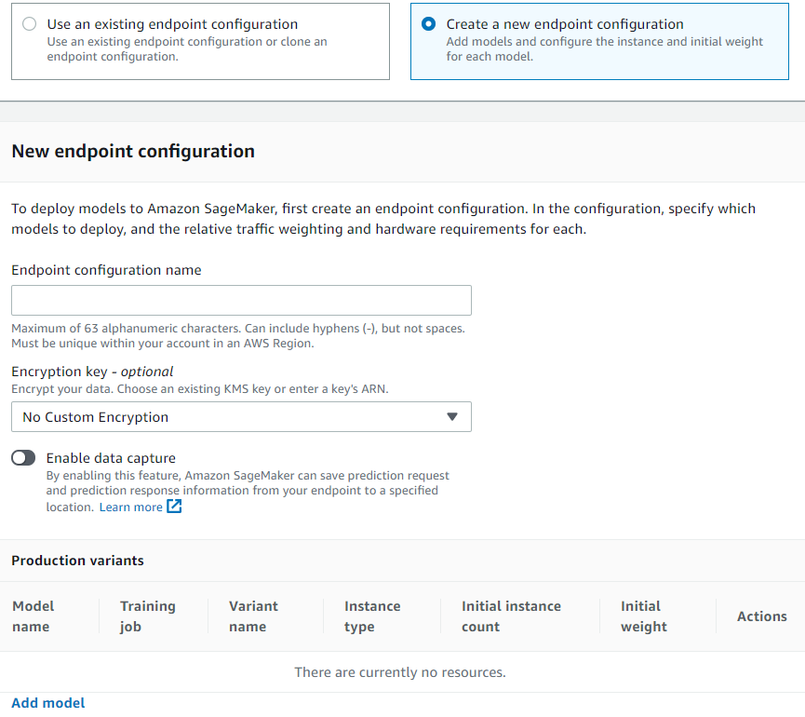
End points
Endpoint name
Create end point configuration
add model

Slide 35
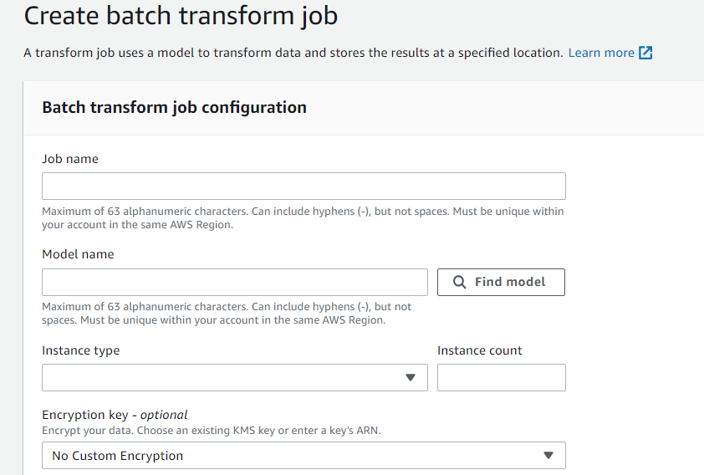
Batch transform job
Use model to transform data

